Slide 1
Multiplatform Watch
Plastics at SEA (http://plastics.sea.edu)

Slide 2
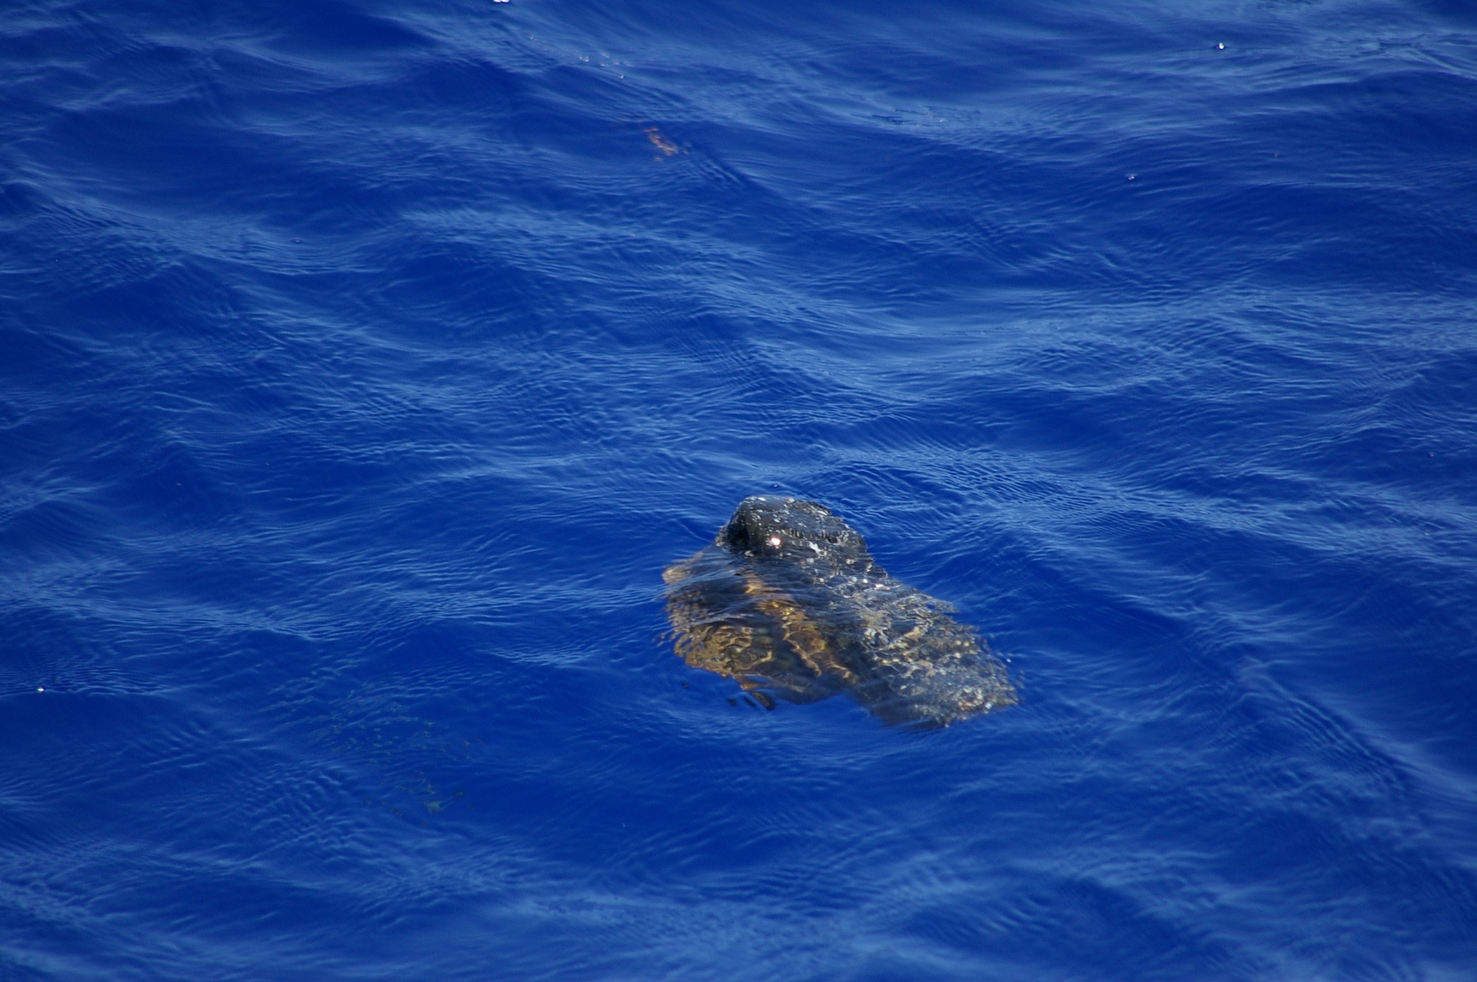
Why we sail
David M. Lawrence

Slide 3
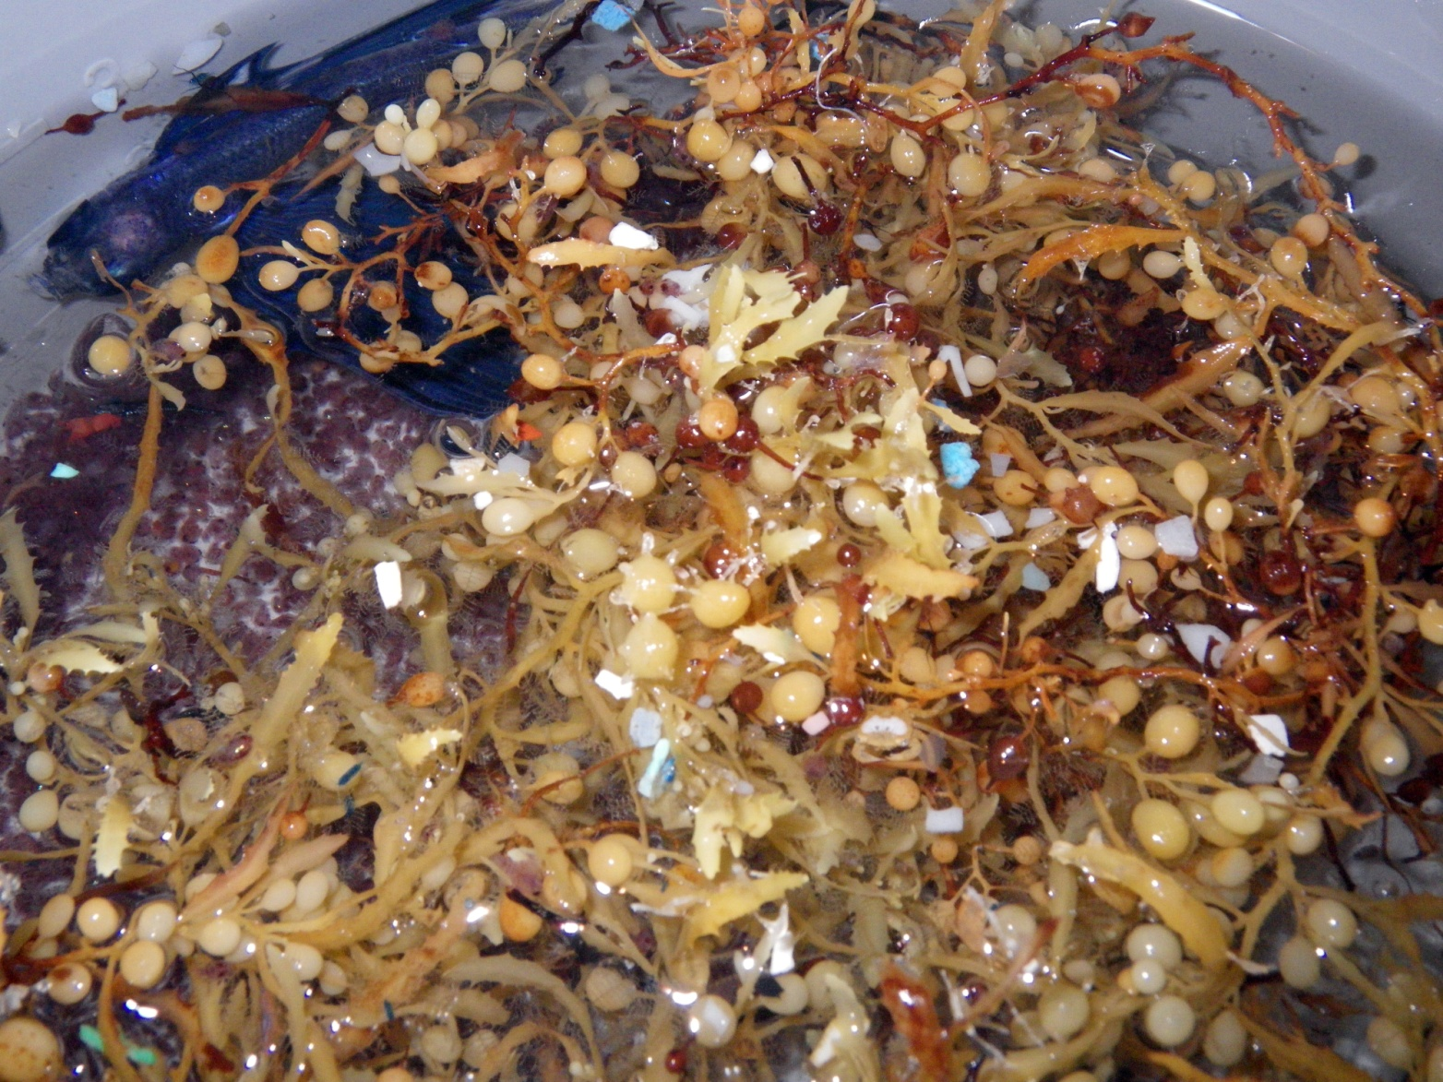
Sargassum and plastic
Skye Moret

Slide 4
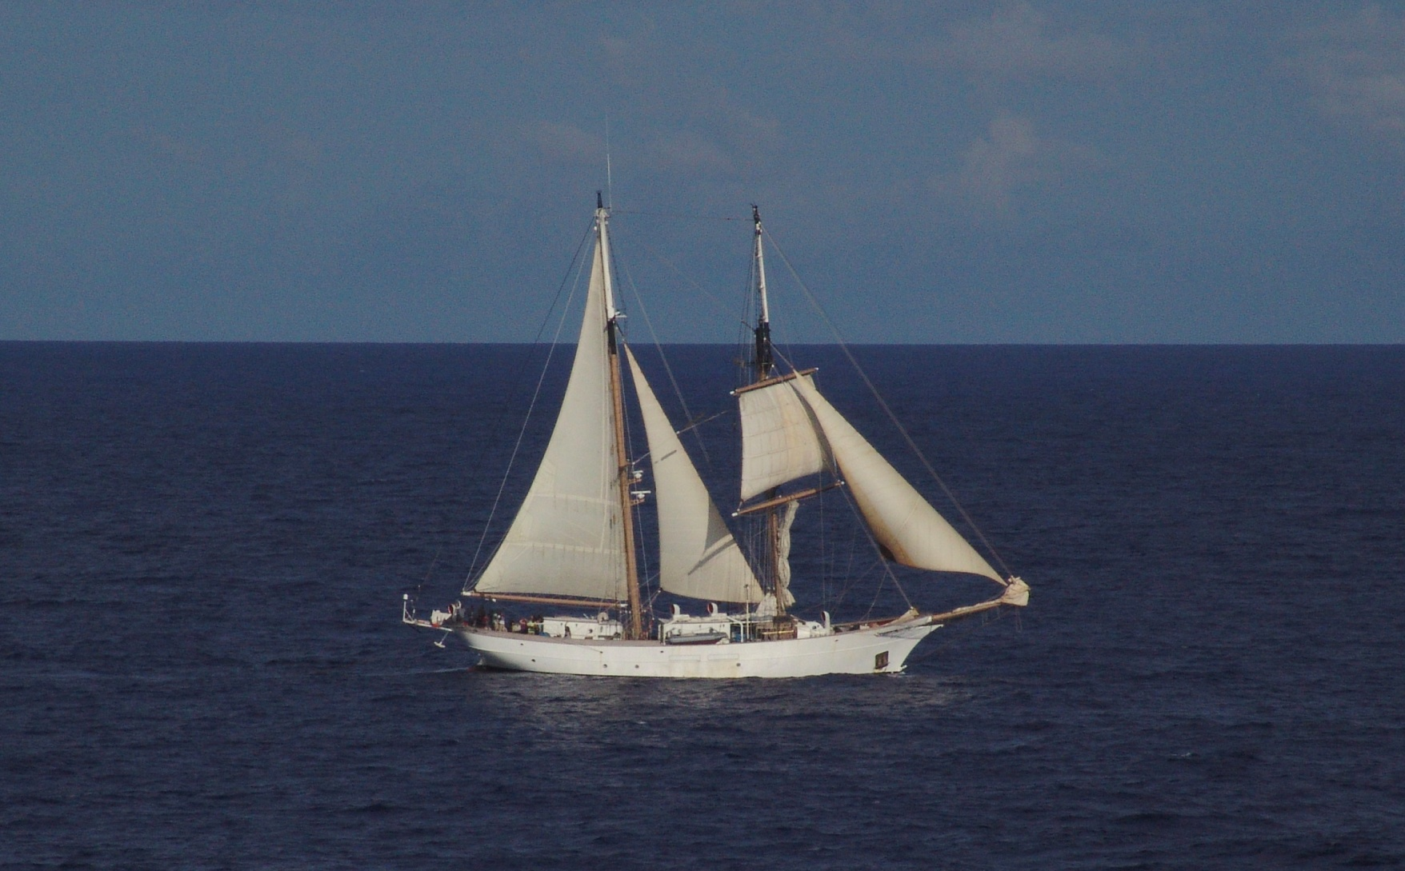
SSV Corwith Cramer
Courtesy Dirk Winebarger, Maersk Constellation

Slide 5
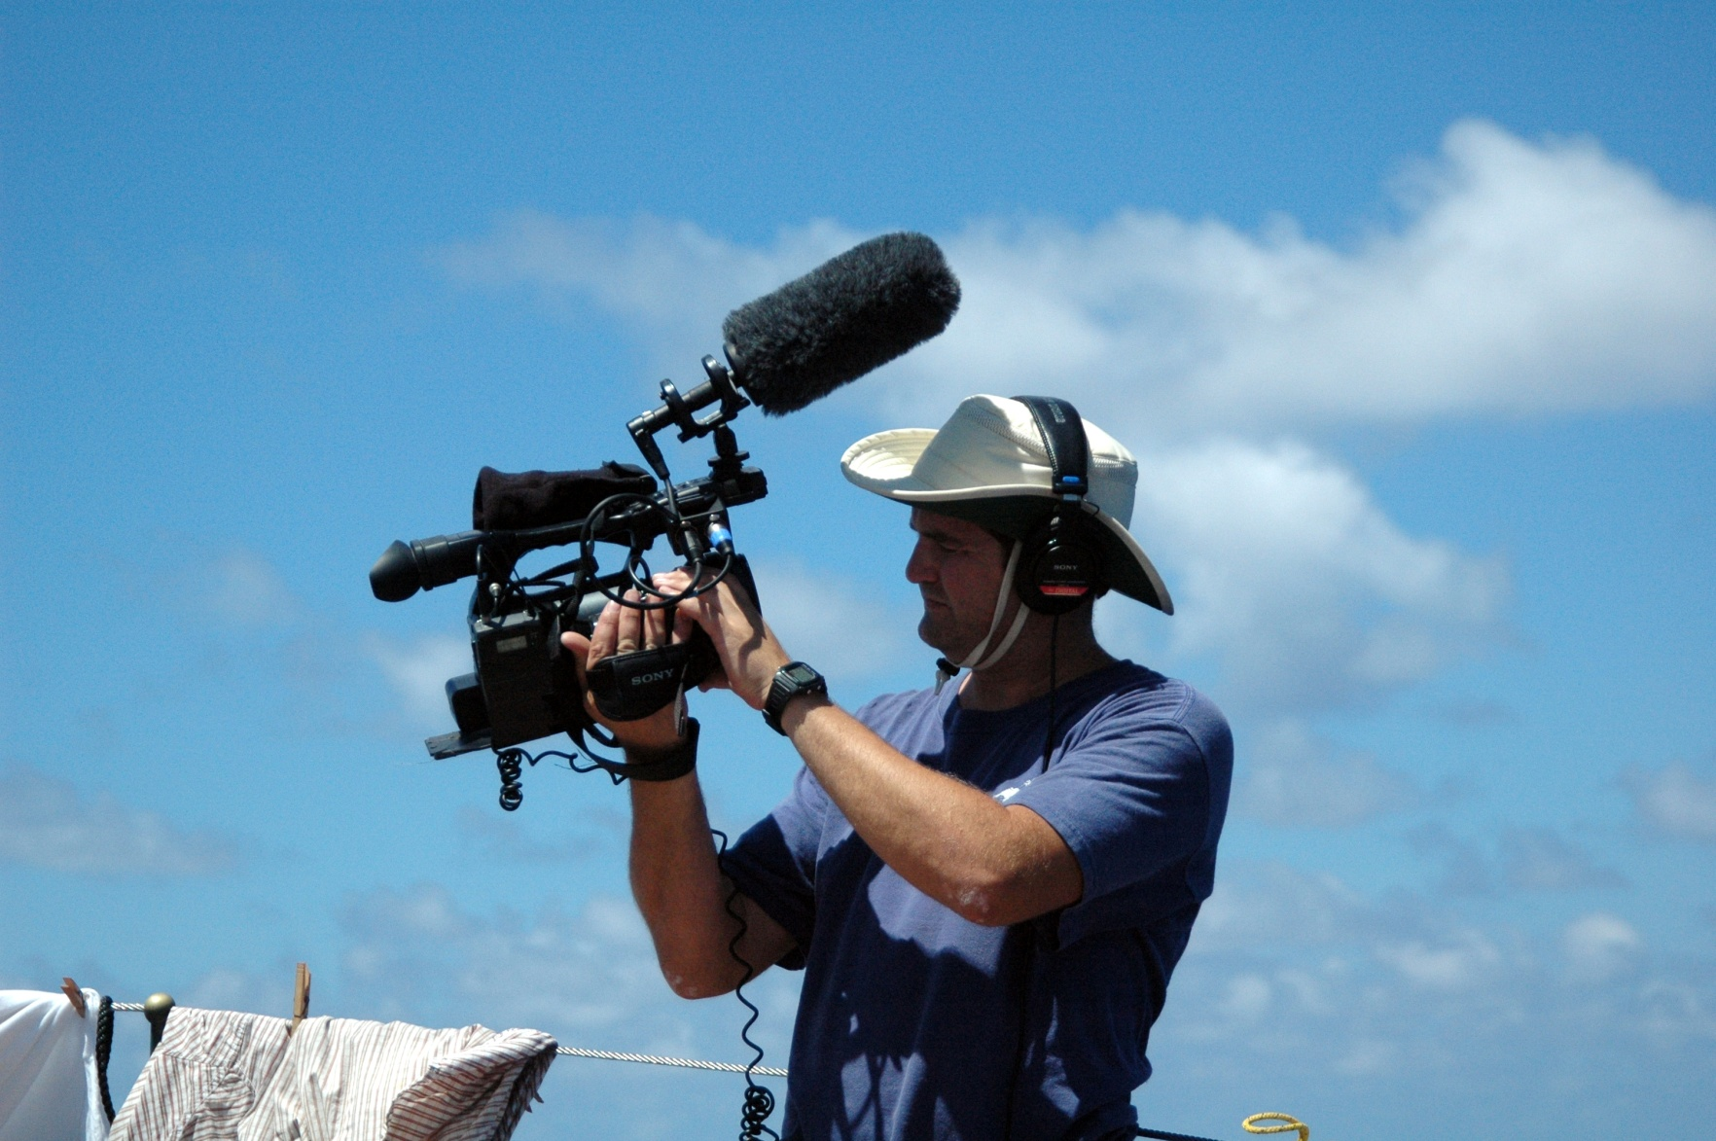
Scott Elliott
Jacob Keaton

Slide 6
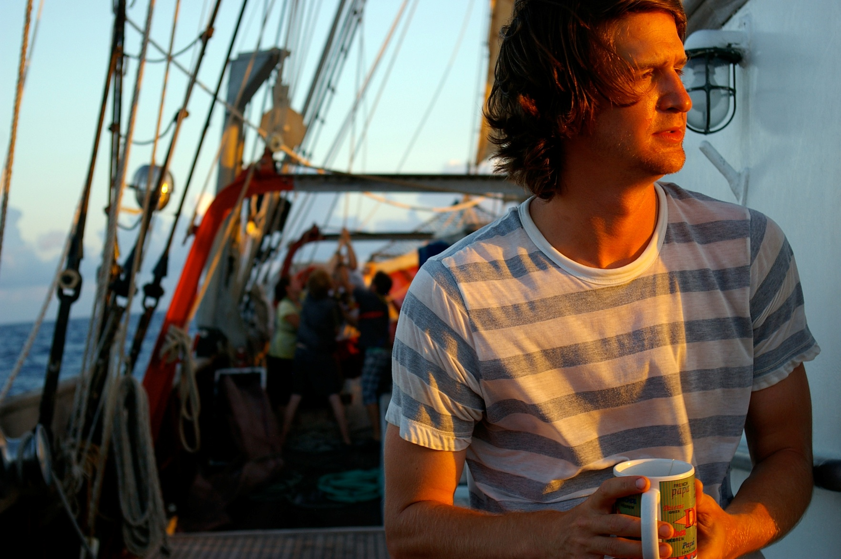
Ben Schellpfeffer
Roman Shor

Slide 7
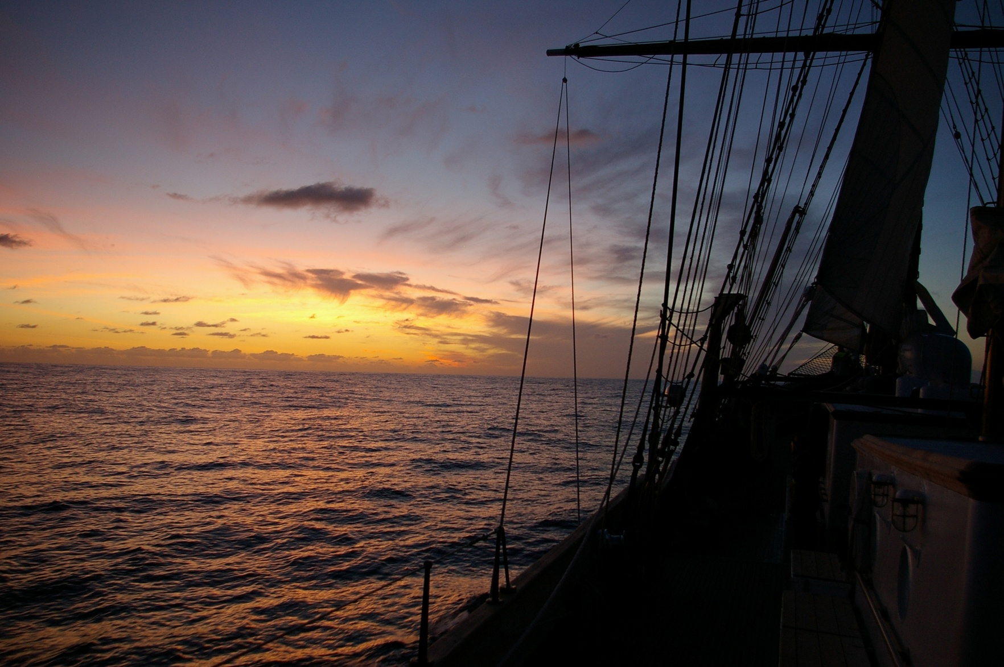
Sunrise over the Sargasso Sea
David M Lawrence

Slide 8
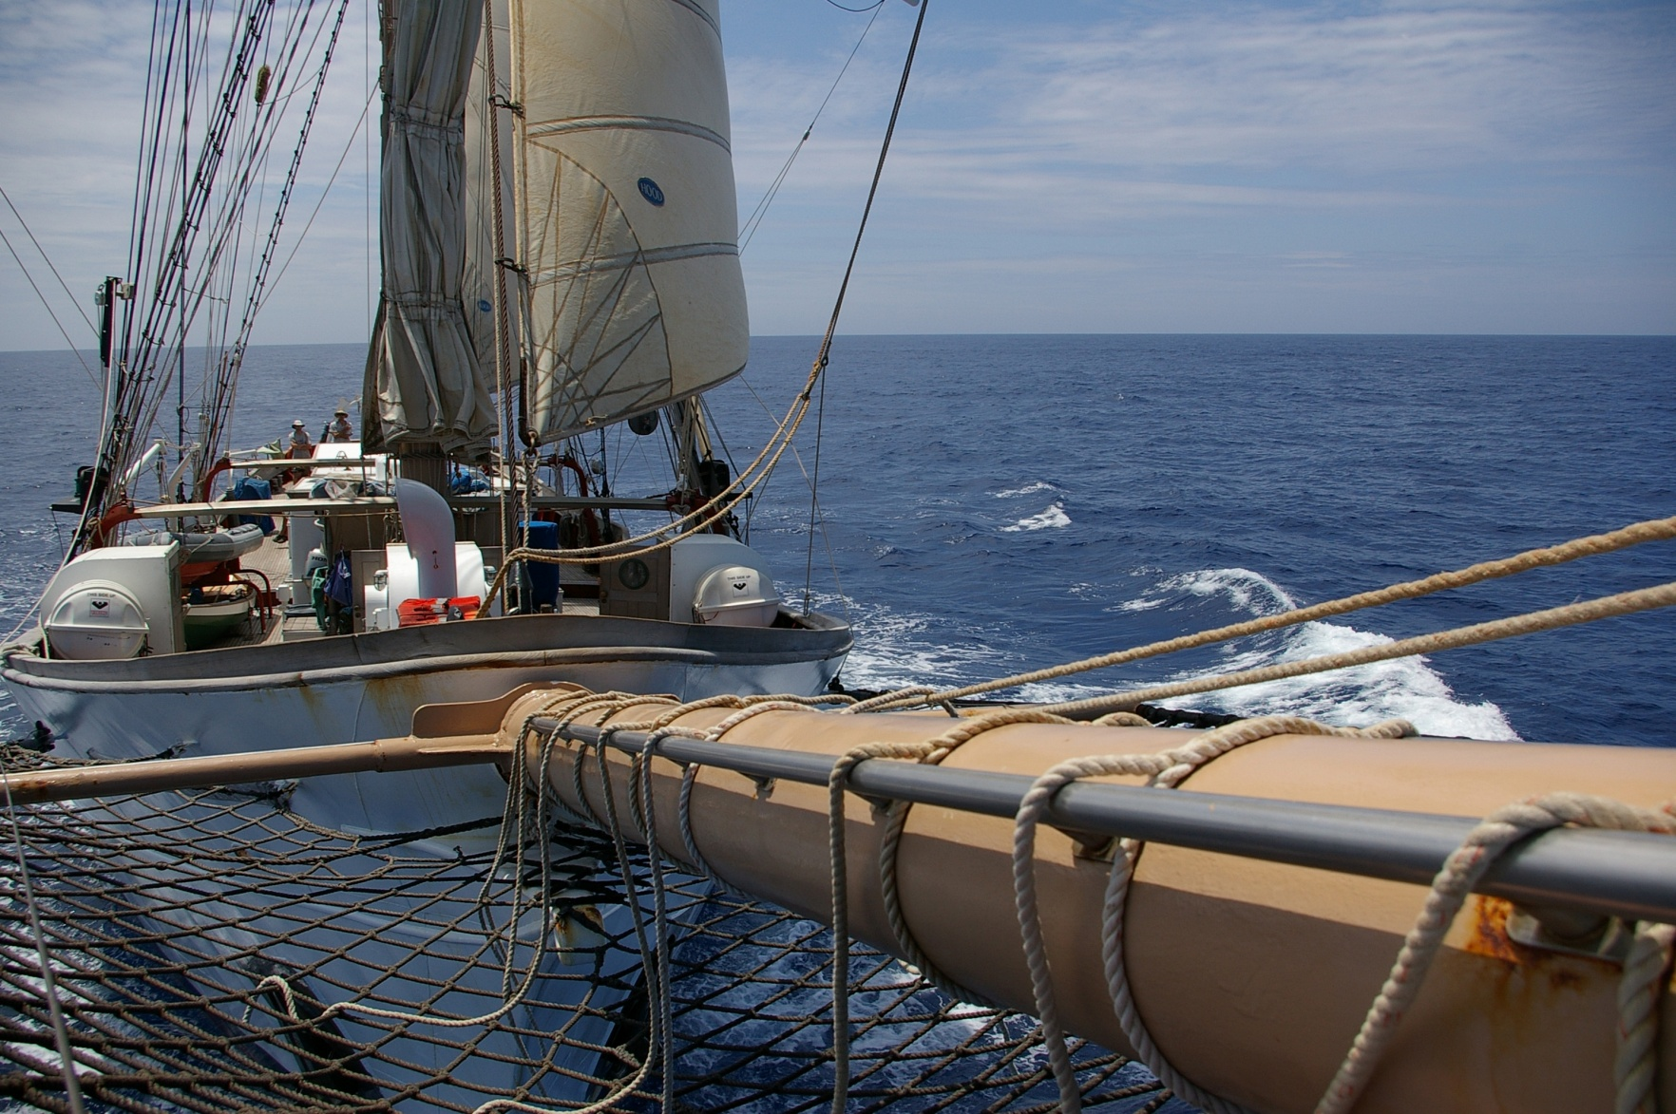
Open sea
David M. Lawrence

Slide 9
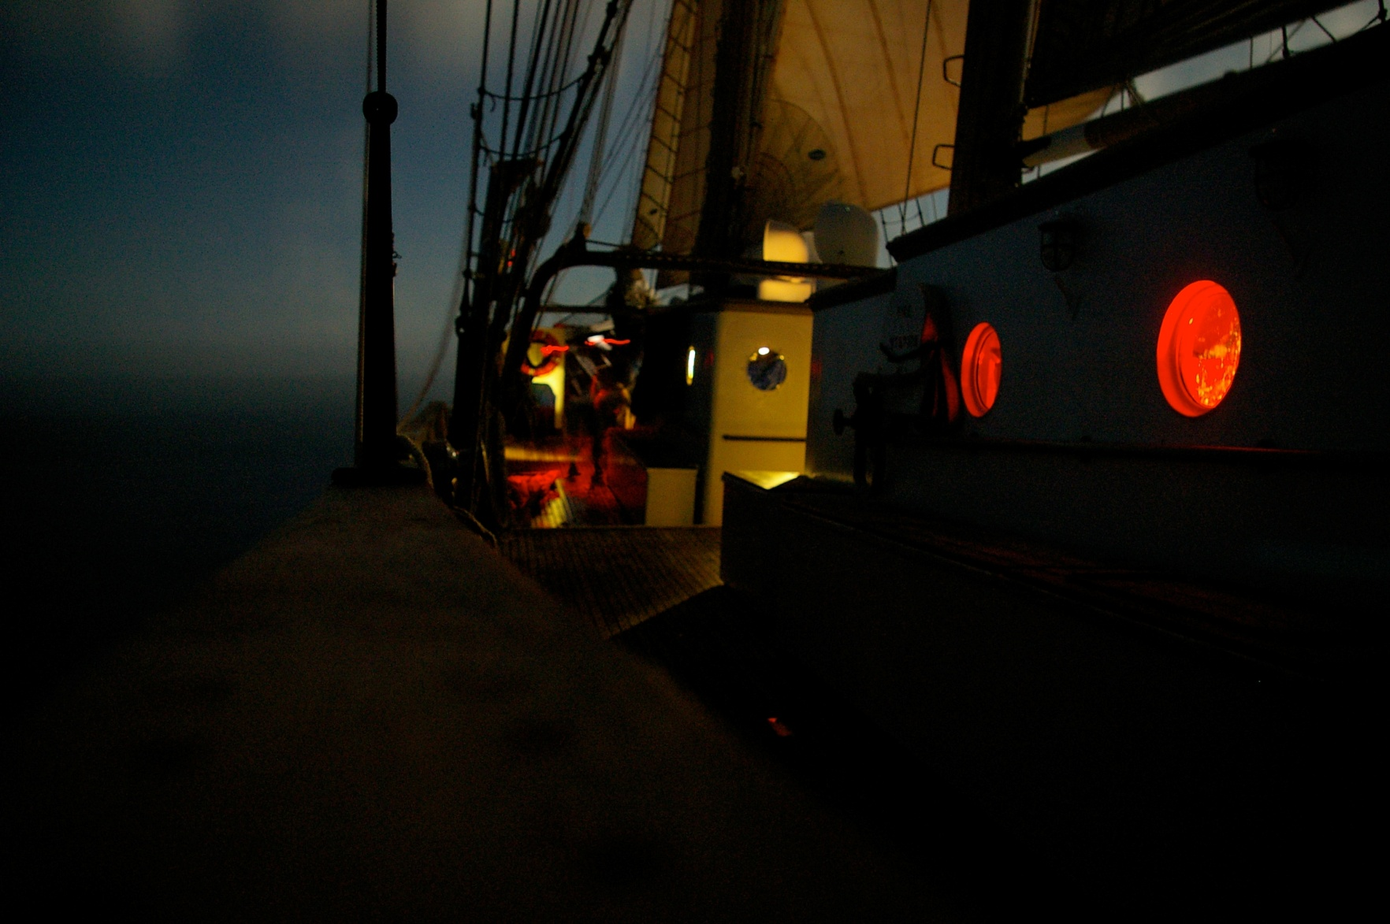
Night lights
Roman Shor

Slide 10
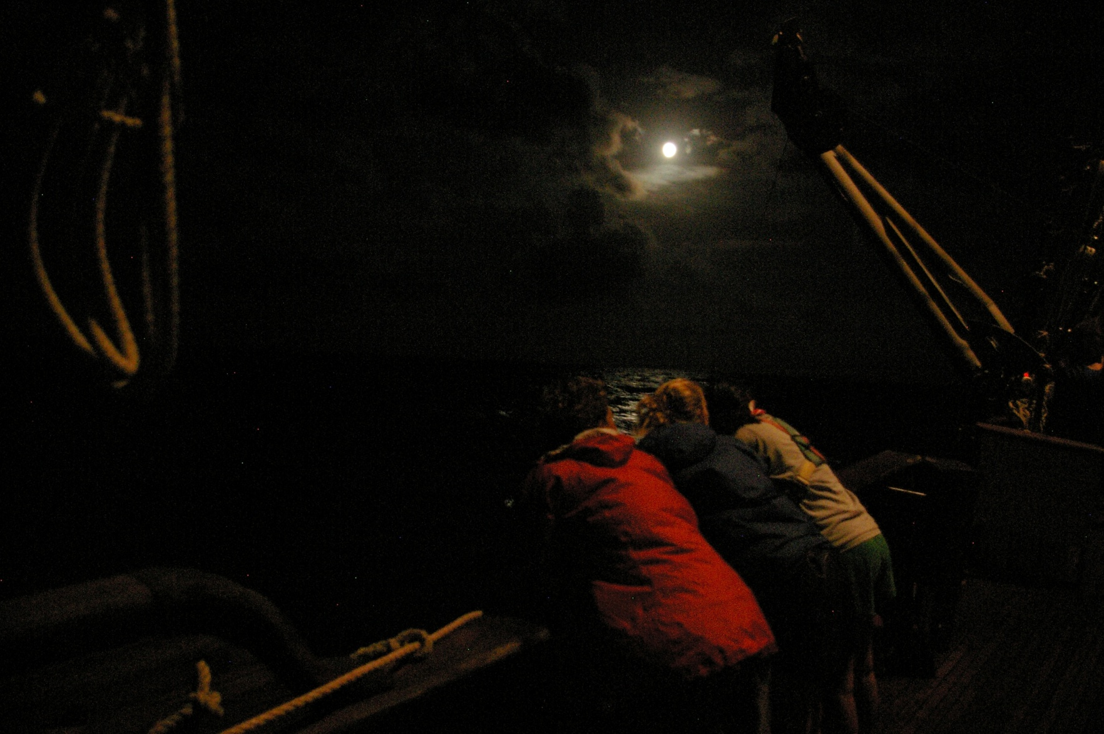
Instrument deployment, graveyard shift
David M. Lawrence

Slide 11
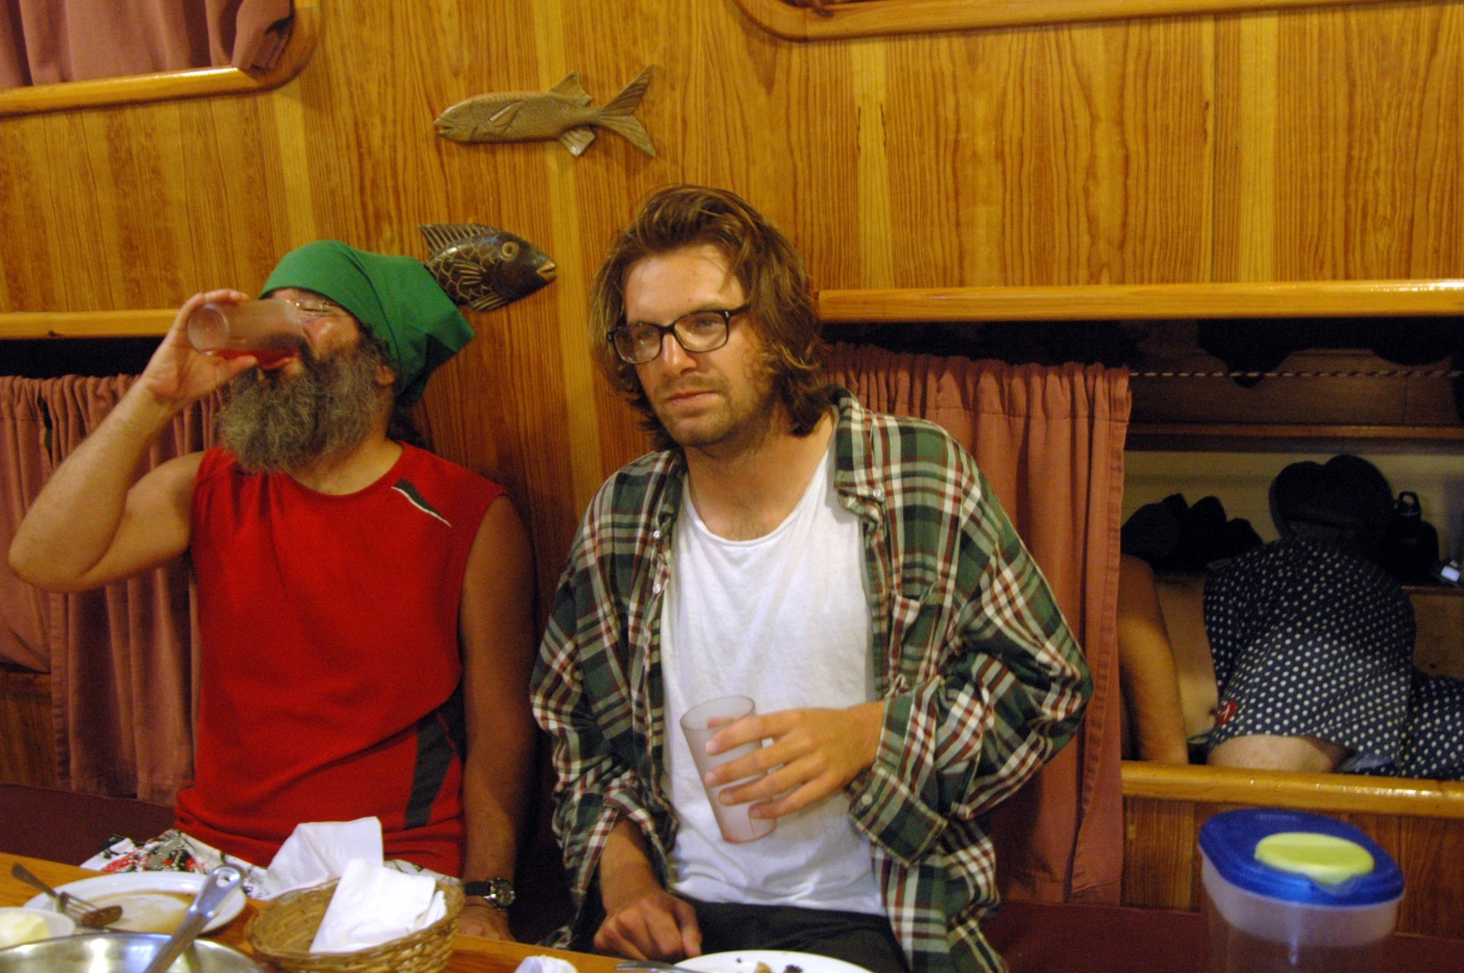
Tight fit
Jacob Keaton

Slide 12
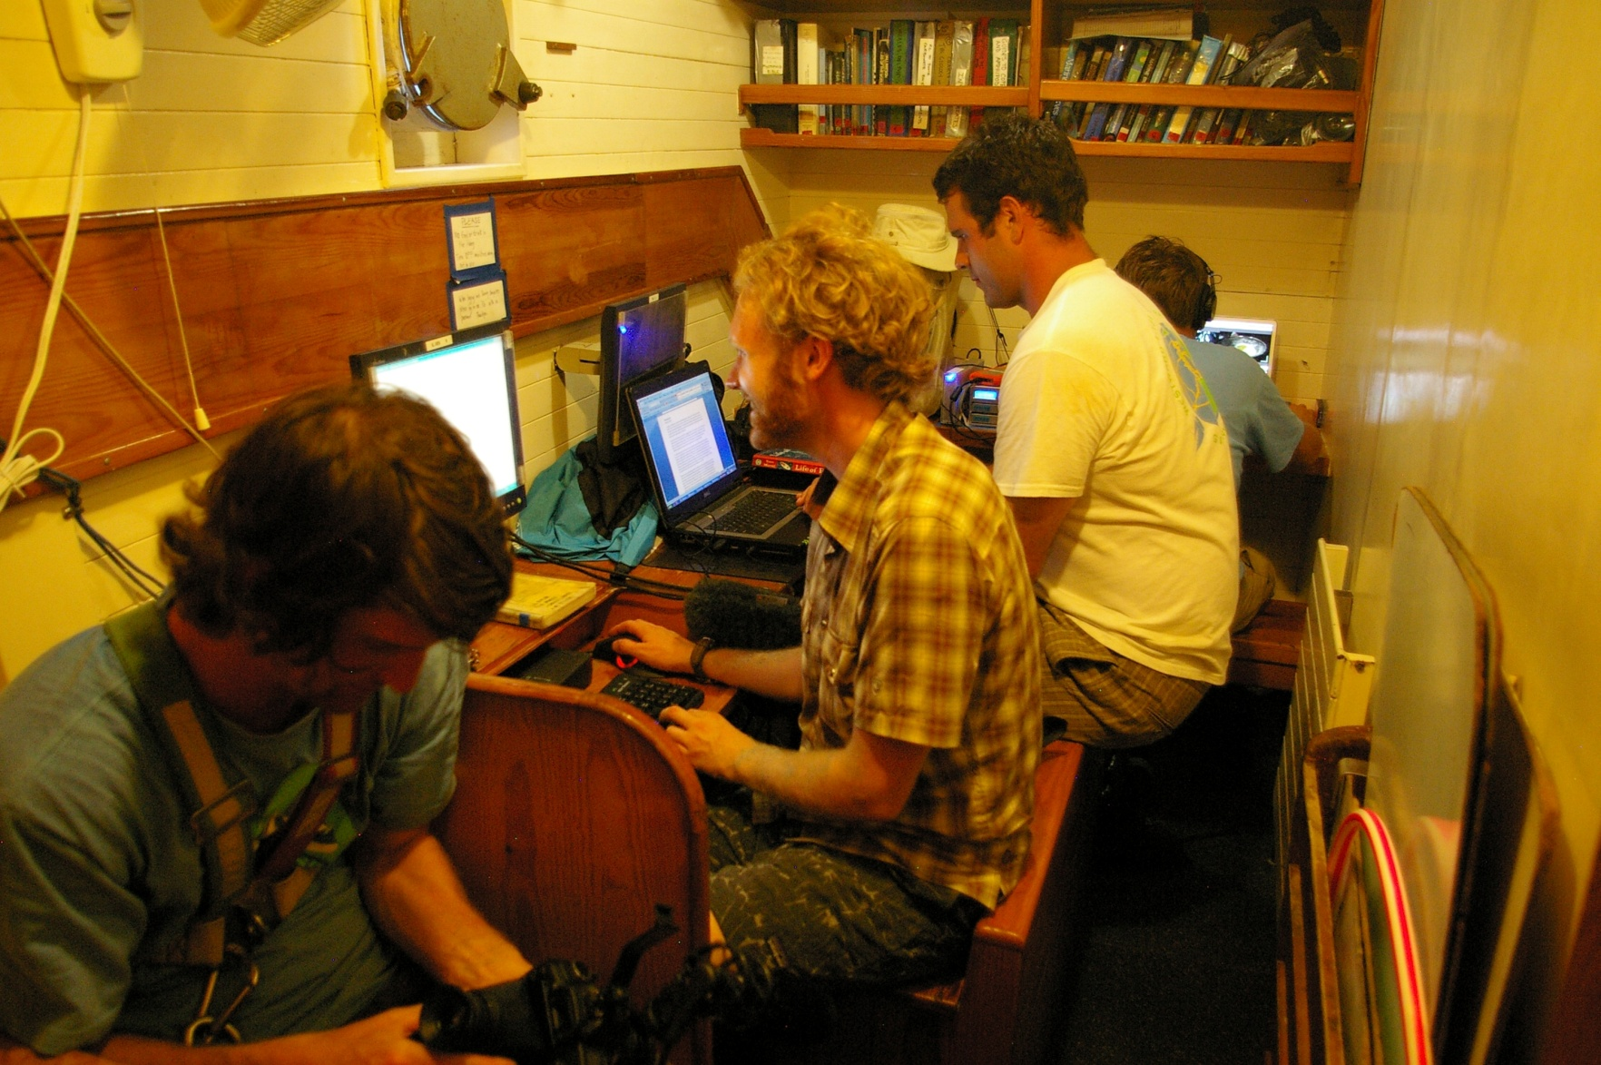
The Newsroom (aka the Man Cave)
David M. Lawrence

Slide 13
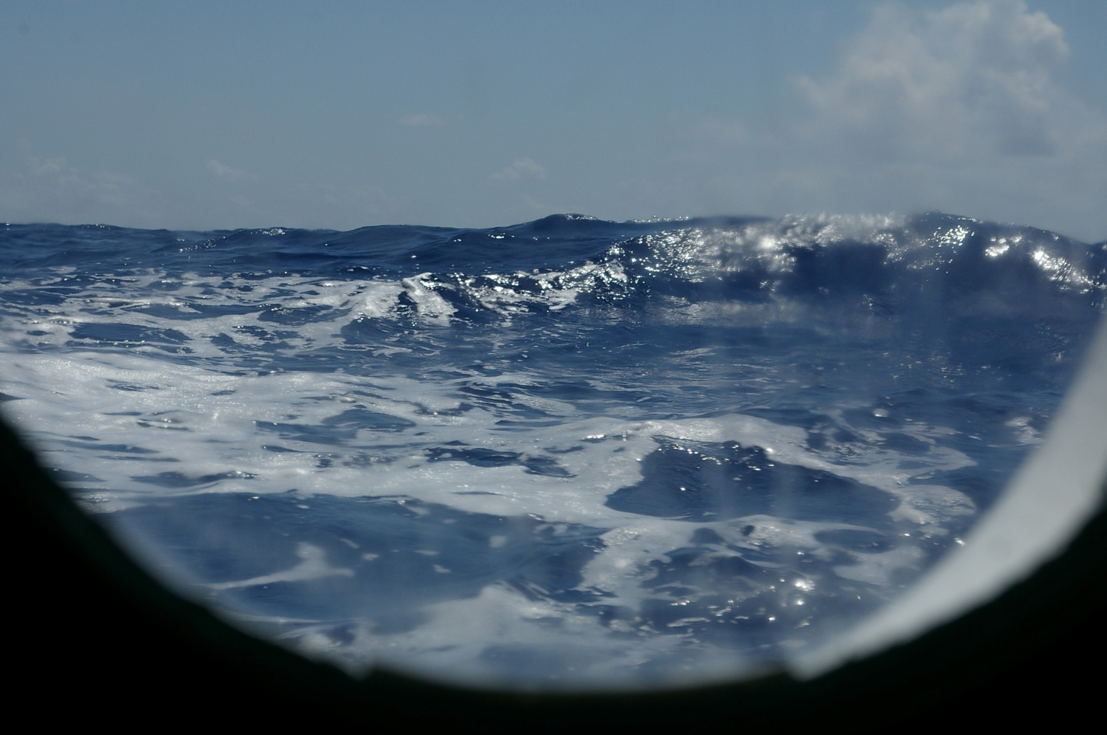
Window seat
David M. Lawrence

Slide 14
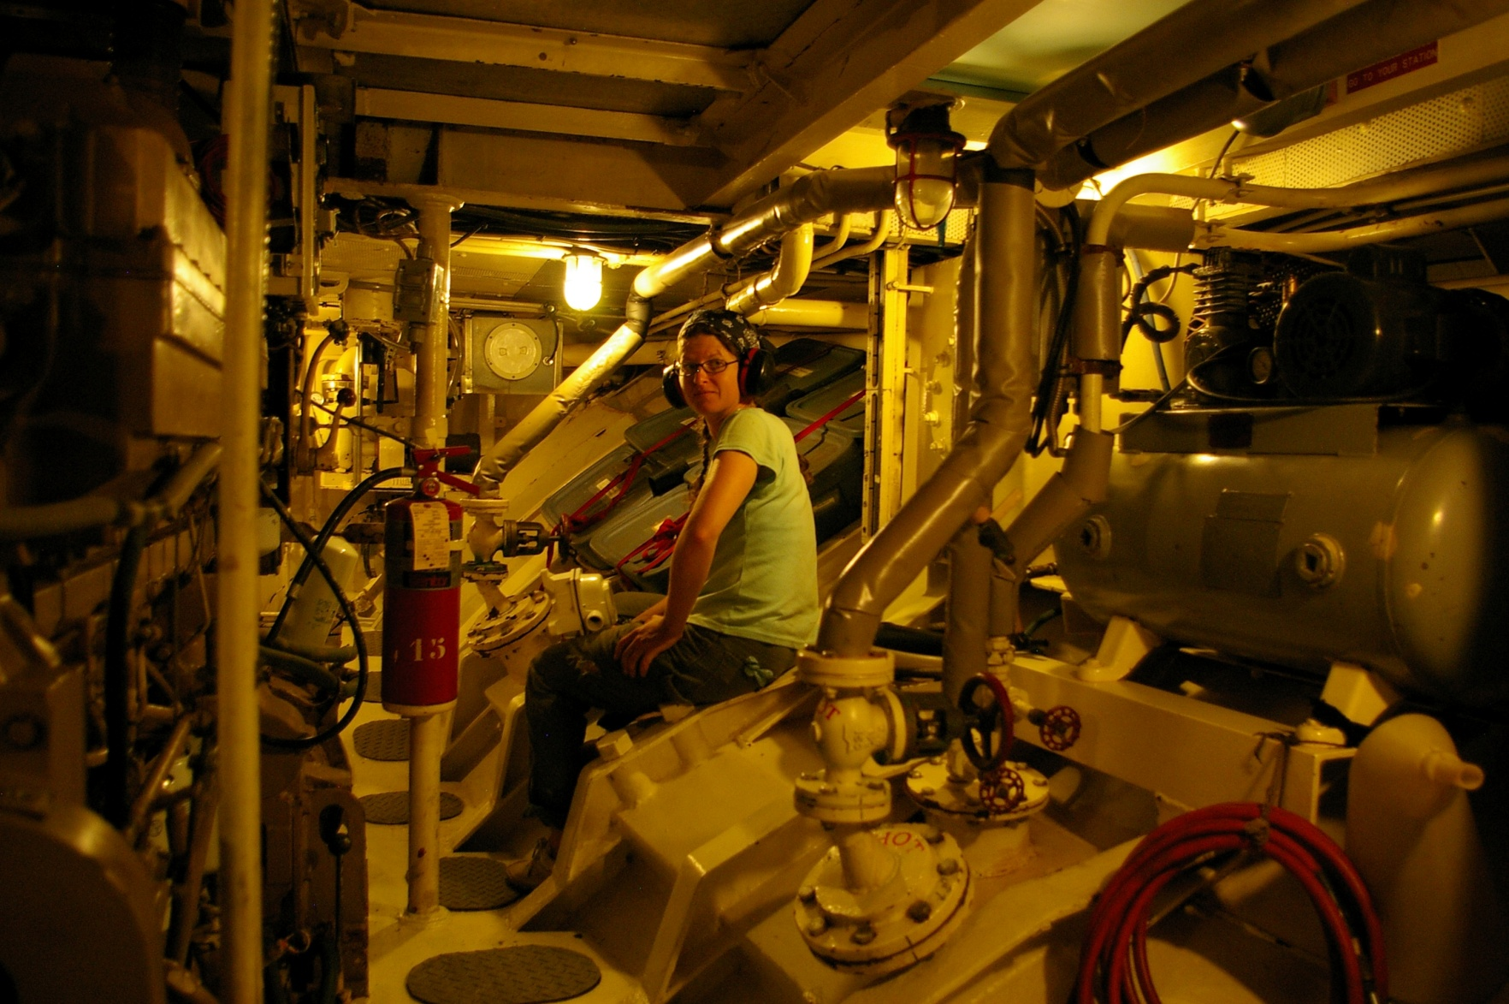
The engine room
David M. Lawrence

Slide 15
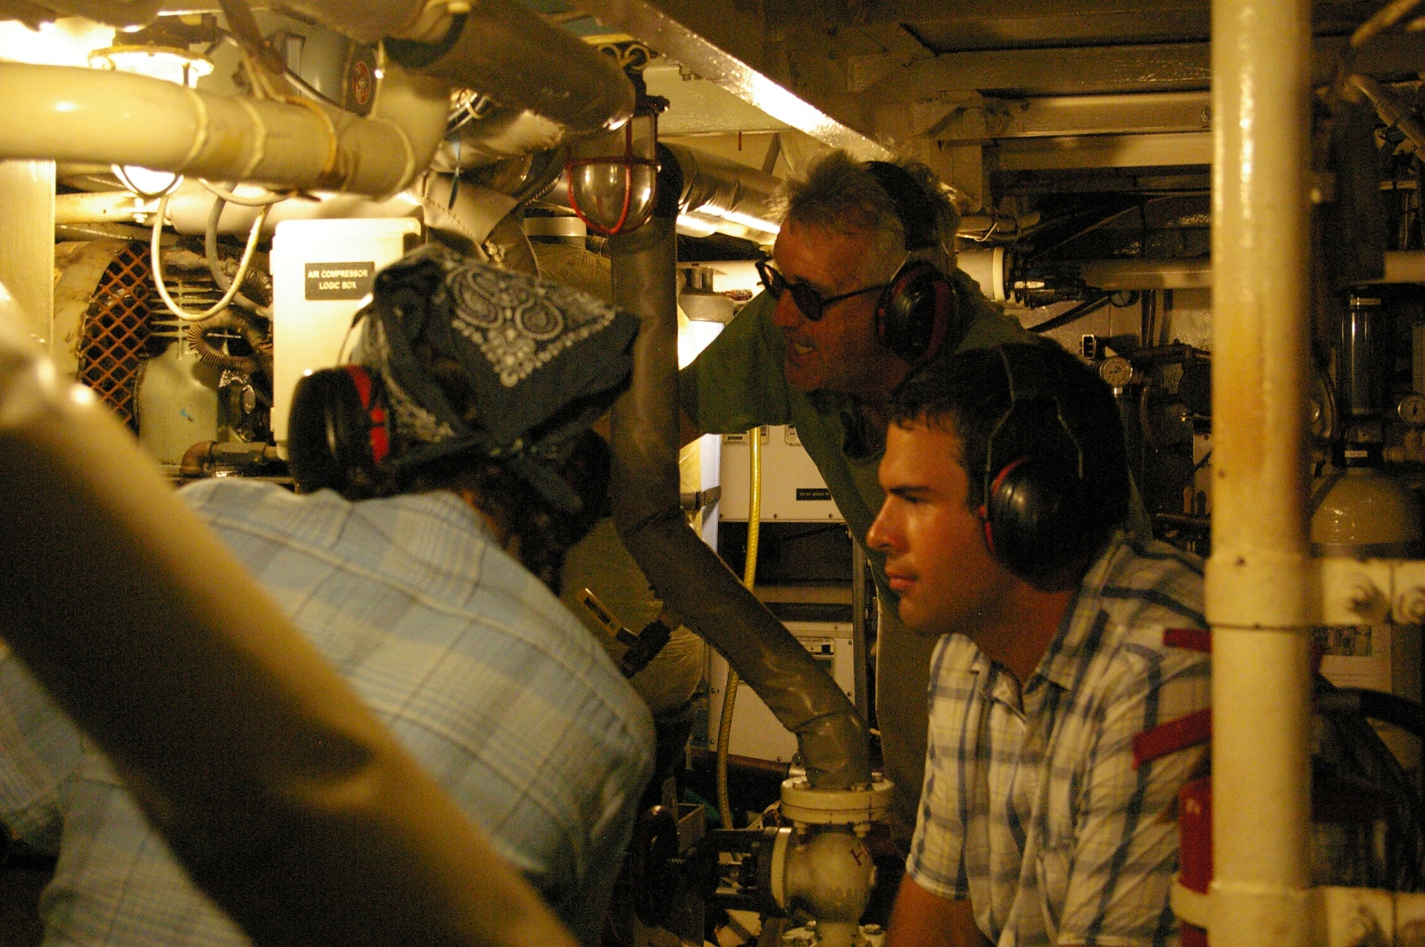
Cramped quarters
David M. Lawrence

Slide 16
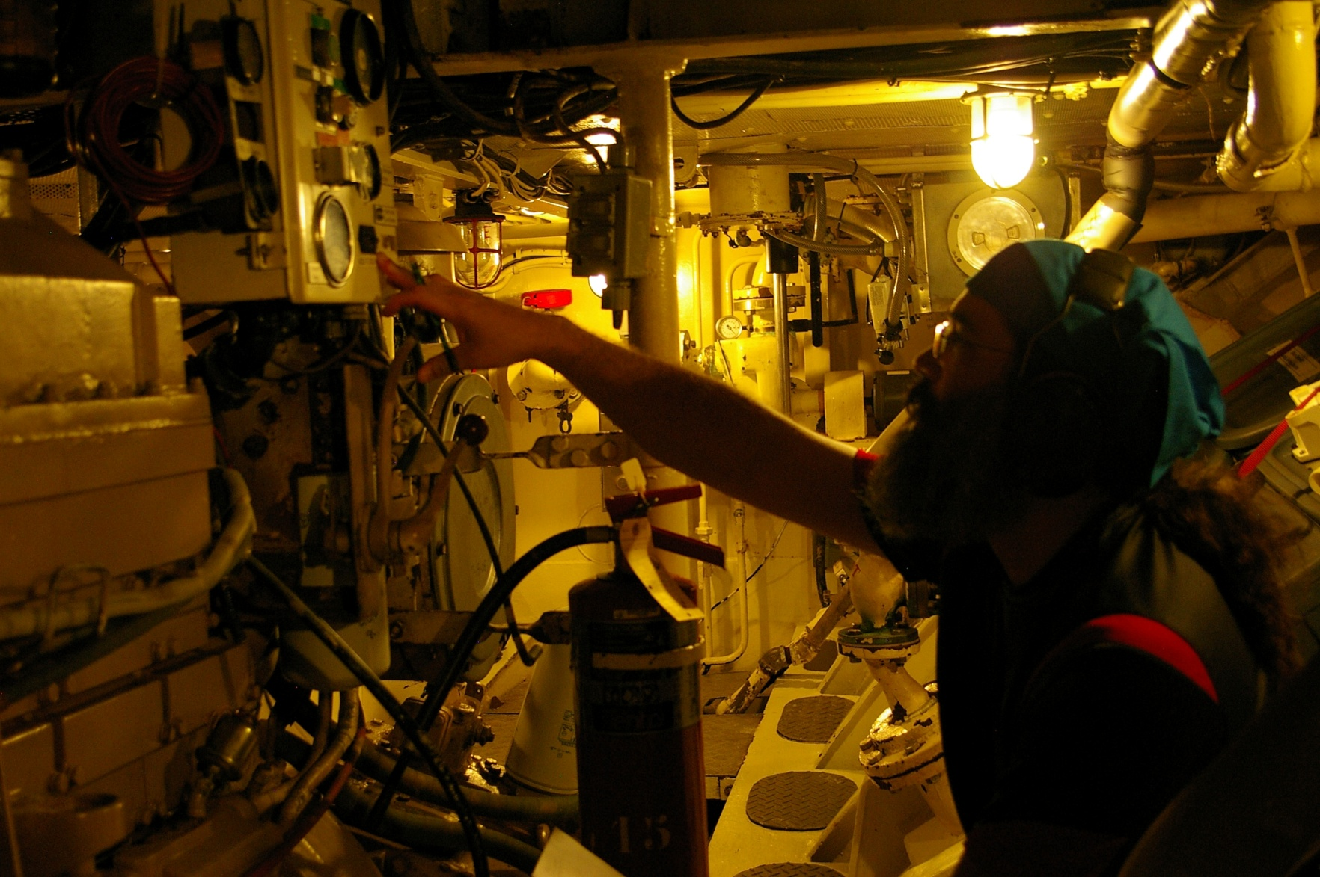
Yes, I worked, too
Sarah Lake

Slide 17
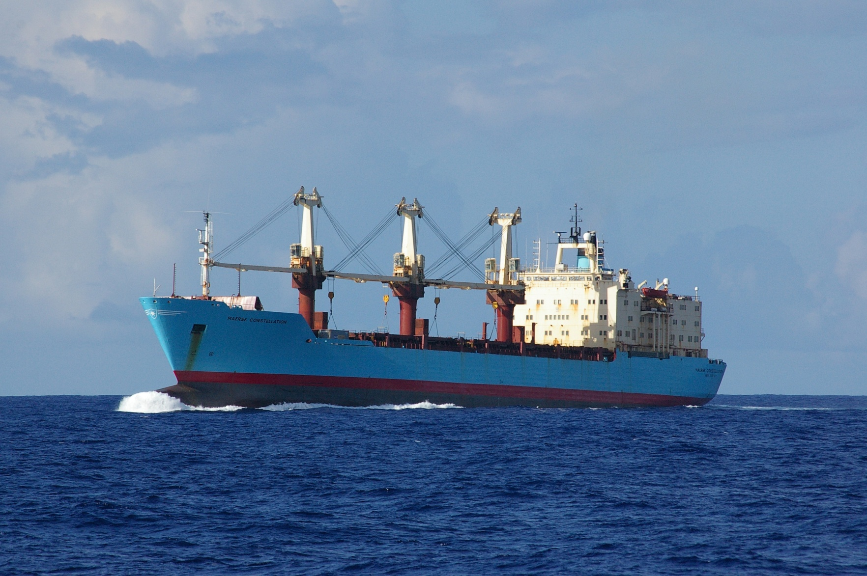
Maersk Constellation
David M. Lawrence

Slide 18
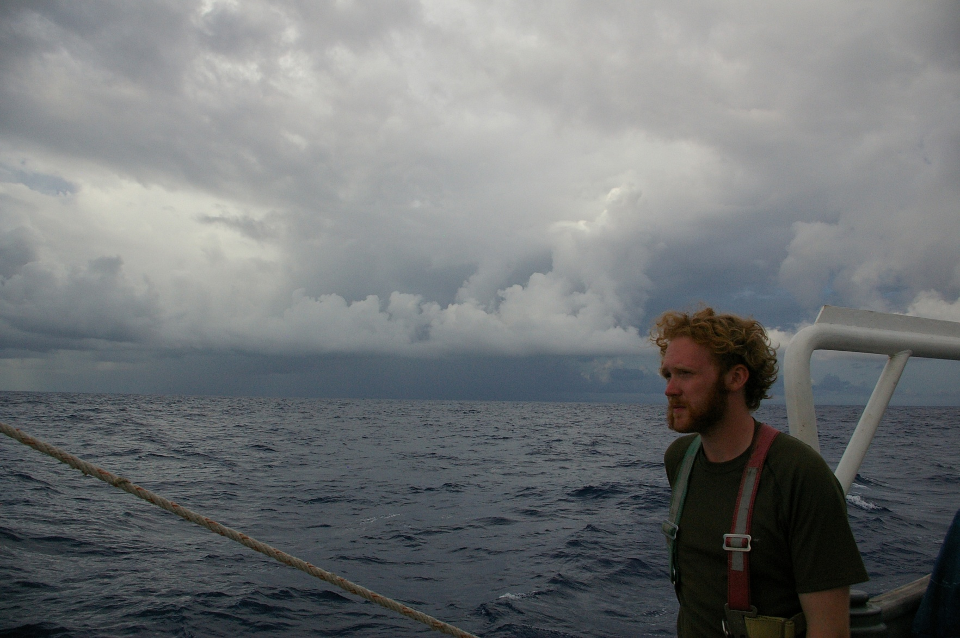
Squall near Bermuda
David M. Lawrence

Slide 19
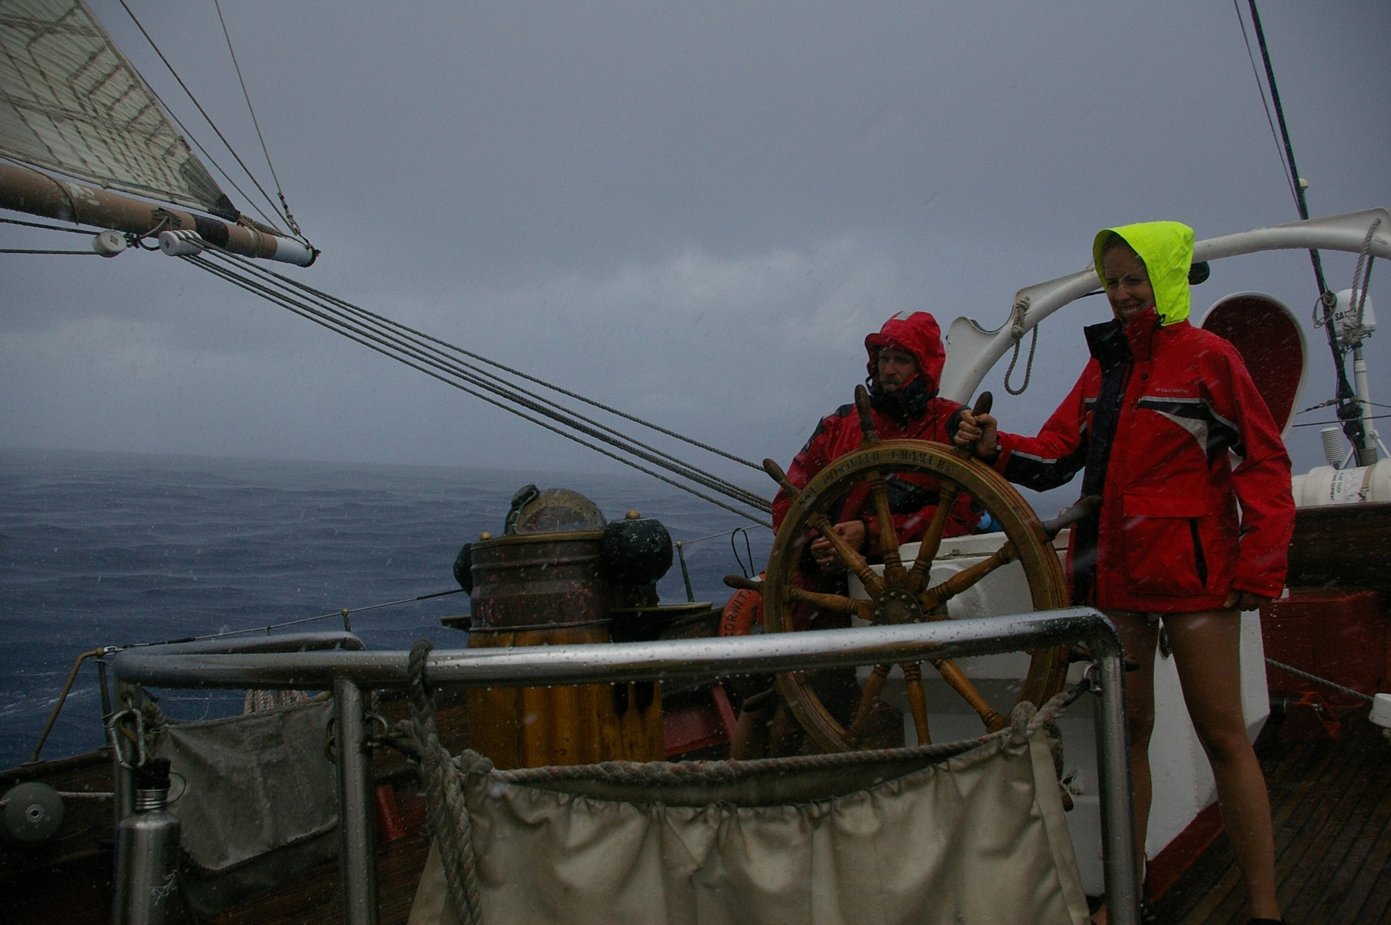
Yes, it’s blowin’
David M. Lawrence

Slide 20
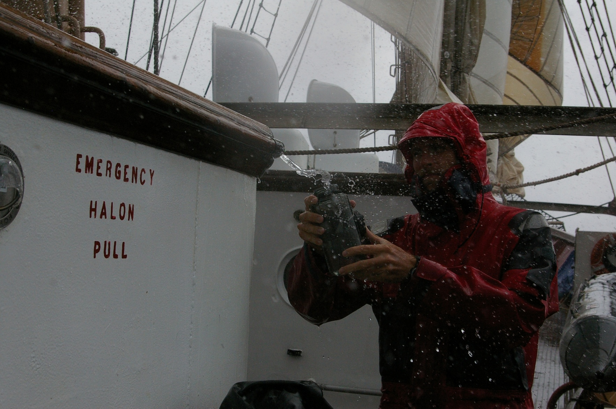
The captain’s thirsty
David M. Lawrence

